Slide 1

Visualization and Analysis – Tutorial Presentation for Feedback Date: 15/11/2024
Group Id: A336 Name of Student Presenting: Muhammad Usman

Slide 2
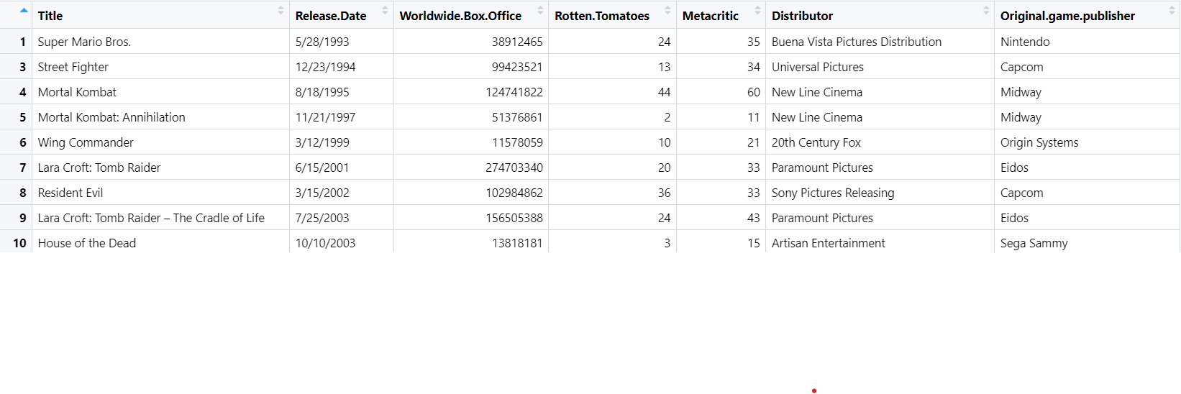
We are using the dataset DS332 video_game_films.csv to answer our Research Question
“Is there a correlation between worldwide box office revenue of the video game films and their rotten tomatoes rating score”?
The dataset has 38 rows and the variables we use are
Dependent variable: Worldwide box office
Independent variable: Rotten tomatoes

Slide 3
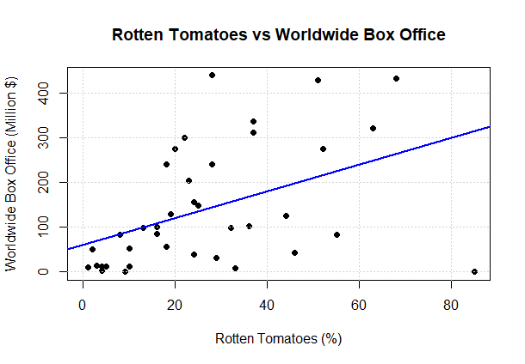
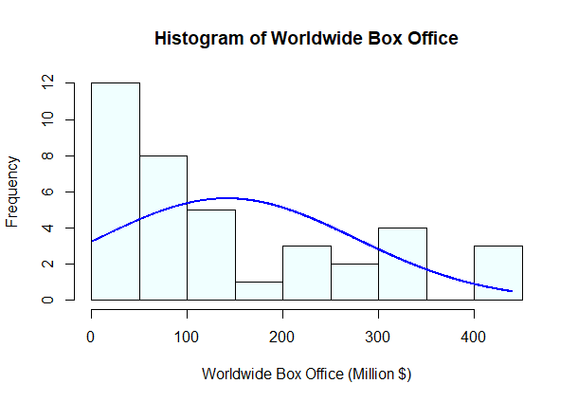
3
Correlation visualizations scatter plot and histogram:

Slide 4
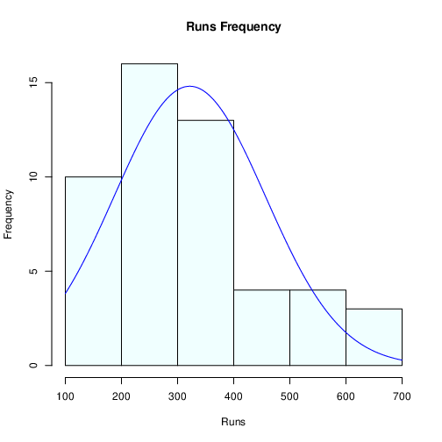
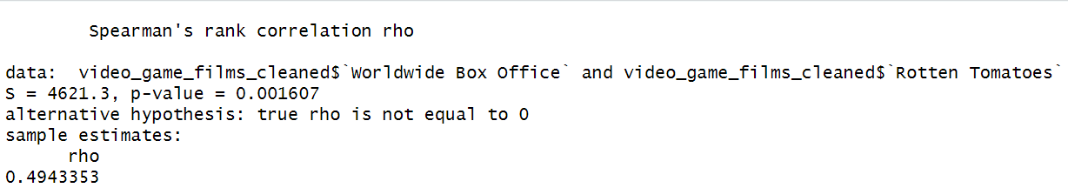
Here is a Histogram showing the frequencies of our dependent variable to include the normal curve overlay.
4
Our RQ asks about Correlation
For example:
Since the worldwide box office variable distribution appears to be non normal based on the histogram and non normal curve overlay, we have used Spearman’s correlation for the test
4
Notes:
4

Slide 5
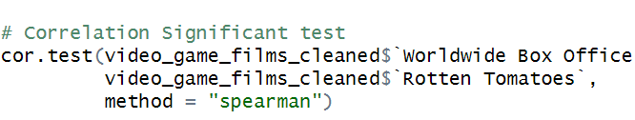
R Script and Results (For ALL types of test) – The Analysis
5
PRE 7COM1079-2022 Student Group No: ?????
5
The p-value 0.01607 is well below the significance level of 0.05.
The results are significant.
we reject the null hypothesis (H₀) which is “ There is no significant correlation between the worldwide box office revenue of the video game films and their rotten tomatoes rating scores”.
There is a moderate positive relationship (rho ≈ 0.49) between critic reviews and box office earnings.
Ratings (as measured by rotten tomatoes) does seem to matter for video game movie success. However, moderate strength suggests it’s not the only important factor
Other factors likely matter too (marketing, release timing, source material popularity.
Notes:
5

